Slide 1
Theory of Automata Computable Functions
Week 15

Slide 2
Contents
Computation
Paradigms
Functions and their computations
Computable and non-computable functions
Computable Functions
Computer Science Law
TM for Computable Functions
Alonzo Church’s Thesis (1936)

Slide 3
What is Computation?
Paradigm instances of computation
Operations on numeric data
Operations on character data
Function computation
Real computers are finite devices, not infinite, like the Turing machine – they can be understood by a circuit model of computation

Slide 4
Three Computational Paradigms
Language acceptance (recognition)
Transduction (transformation of an input into an appropriate output)
Function computation (natural numbers only)
Language Generation (to list out all the words in the language, also known as enumerating the language)
Turing machines implement each of these paradigms

Slide 5
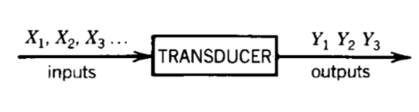
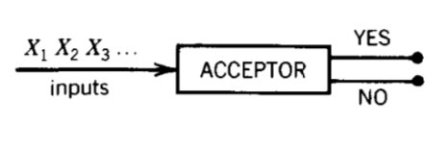
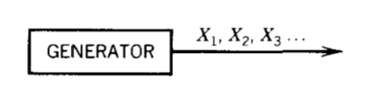

Slide 6
Functions and Their Computation
Function
A correspondence between a collection of possible input values and a collection of output values
Each possible input is assigned a unique output
Computing the function
Process of determining the particular output value that assigns to a given input

Slide 7
Computable and Non-computable Functions
Computable functions
Functions whose output values can be determined algorithmically from their input values
Non-computable functions
Functions that are so complex that there is no well-defined, step-by-step process for determining their output based on their input values
The computation of these functions lies beyond the abilities of any algorithmic system

Slide 8
A Turing Machine
Captures the essence of computational process
Its computational power is as great as any algorithmic system
If a problem can not be solved by a Turing machine, it can not be solved by any algorithmic system
Represents a theoretical bound on the capabilities of actual machines

Slide 9
A function
has:
Domain:
Result Region:

Slide 10
Integer Domain
Decimal:
5
Binary:
101
Unary:
11111
We prefer unary representation:
easier to manipulate with Turing machines

Slide 11
Computable Function
If TM takes a sequence of numbers as input and leaves only one number as output, we say that the computer has acted like a mathematical function. Any operation that is defined on all sequence of K numbers ( for some K ≥1) and that can be performed by a TM is called Turing Computable or just computable.
Example addition, subtraction, max, min, multiplication are computable function and defined for K = 2.
Identity, successor are computable functions defined for K = 1, so there is only one input

Slide 12
A function is computable if
there is a Turing Machine such that:
Initial configuration
Final configuration
initial state
final state
For all
Domain

Slide 13
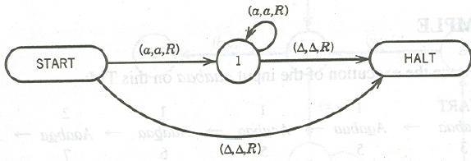
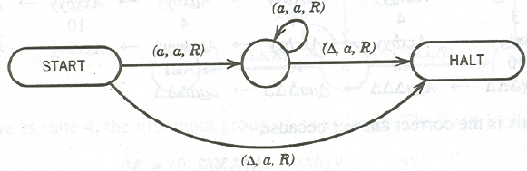
Identity TM
Successor TM

Slide 14
Example
The function
is computable
are integers
Turing Machine:
Input string:
unary
Output string:
unary

Slide 15
Start
initial state
The 0 is the delimiter that
separates the two numbers

Slide 16
Turing machine for function

Slide 17
Execution Example:
Time 0
(2)
(2)
Final Result

Slide 18
Another Example
The function
is computable
is integer
Turing Machine:
Input string:
unary
Output string:
unary

Slide 19
Start
initial state
Finish
final state

Slide 20
Turing Machine Pseudocode for
Replace every 1 with $
Repeat:
Find rightmost $, replace it with 1
Go to right end, insert 1
Until no more $ remain

Slide 21
Computer Science Law:
A computation is mechanical iff it can be performed by a Turing Machine
There is no known model of computation
more powerful than Turing Machines

Slide 22
Turing Machine for

Slide 23
Start
Example
Finish

Slide 24
Another Example
if
The function
if
is computable

Slide 25
Turing Machine for
if
if
Input:
Output:
or

Slide 26
Turing Machine Pseudocode:
Repeat
Match a 1 from with a 1 from
Until all of or is matched
If a 1 from is not matched
erase tape, write 1
else
erase tape, write 0

Slide 27
Alonzo Church’s Thesis (1936)
“It is believed that there is no functions that can be defined by humans, whose calculation can be described by any well-defined mathematical algorithm that people can be taught to perform, that cannot be computed by TM”
Unfortunately the Church thesis is not a theorem because the terms ( in red) are not part of any math branch and mathematical axioms deals with “people”.

Slide 28
Examples
ADDER (two binary numbers)
Input $1111$1111111∆
Output $$11111111111∆
SIMPLE SUBTRACTION (two unary numbers)
Input aaaabaa∆
Output aab∆
MULTIPLICATION (two unary numbers)
Input baaabaa#
Output b∆∆∆∆∆∆∆aaaaaa
Square Root (two unary numbers)

Slide 29
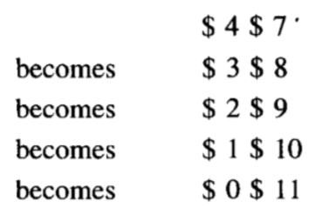
ADDER (adds two binary numbers

Slide 30
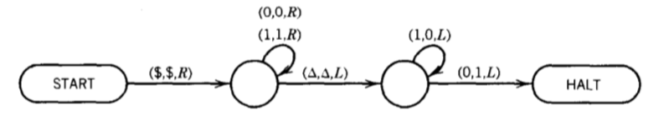
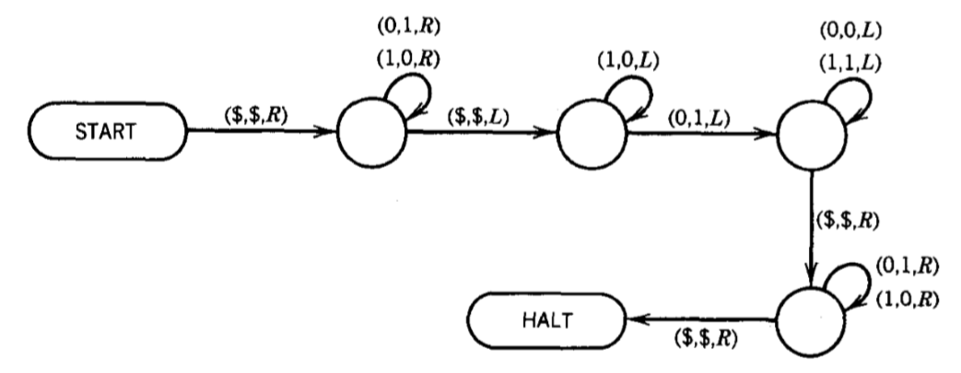
Increments by 1
Decrements by 1

Slide 31
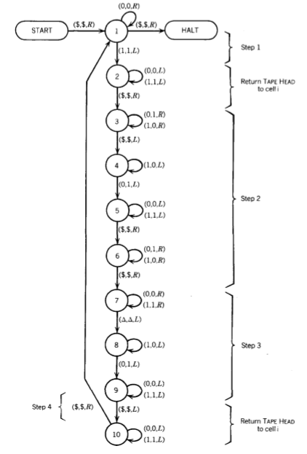

Slide 32
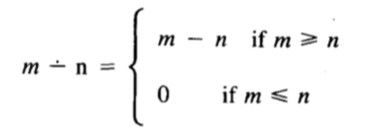
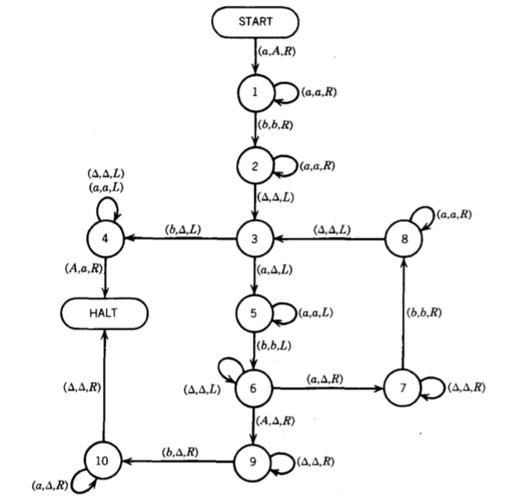
SIMPLE SUBTRACTION

Slide 33
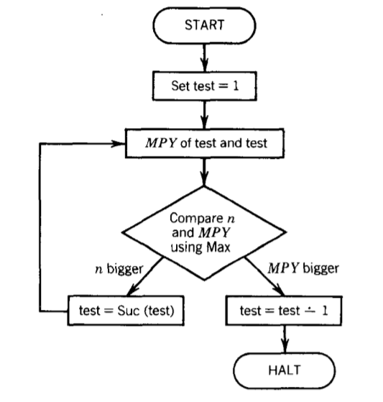
SQURE ROOT
Input: 10
Output:3
Input: 20
Output: 4

